Slide 1
Example Class 4
Group 2:
Annie (Speaker 1)
Jason
Kenrick (Speaker 2)
Lewis
Stephen (Speaker 3)

Slide 2
Project 4B
Step 1 - City and Graph structure implementation
Step 2 - Generating Graphs with different size and density
Step 3 - Implement BFS and DFS algorithm
Step 4 - Analysis of BFS and DFS results

Slide 3
Step 1 - City and Graph structure implementation
2 separate classes: City and Graph
Each city has a name, a cityID, a boolean value to marked as visited/unvisited, and a linked list of neighbor cities
Graph consists of a linked list of Cities, and have methods to connect 2 cities within graph
adjacency list

Slide 4
Step 2 - Generating Graphs with different size and density
A class GraphGenerator is used to generate a Graph of a specified size and density by getting Cities from an existing file and connecting them randomly until the density required is reached
Range of Graph size: from 100 to 1000
In order to generate graphs of same size but different densities, we construct a graph of the lowest density first, then add more edges until the density required is reached

Slide 5
Step 2.1 - buildNonStopFlights()
Adjacency Matrix
O(1)
Array of Adjacency Lists
O(|V|)
Where:
V (vertices) = Cities

Slide 6
Step 3 - Implementation of BFS and DFS
Both are implemented in the Searcher class,
BFS uses a queue to store Cities to be visited, while
DFS uses a stack to do so.
When BFS finds the destination, it returns the shortest path immediately.
When DFS finds destination, it compares with other paths found until searching through entire graph.

Slide 7
Step 4 - Analysis of BFS and DFS results
How search time relates to number of cities and non-stop flights?
In general, the time complexity of BFS is O(|V+E|) as we use adjacency lists, where |V| is the number of cities (vertices) and |E| is the number of non-stop flights (edges).
But, in some cases when there’s a non-stop flight, the search time could be far less than expected.

Slide 8
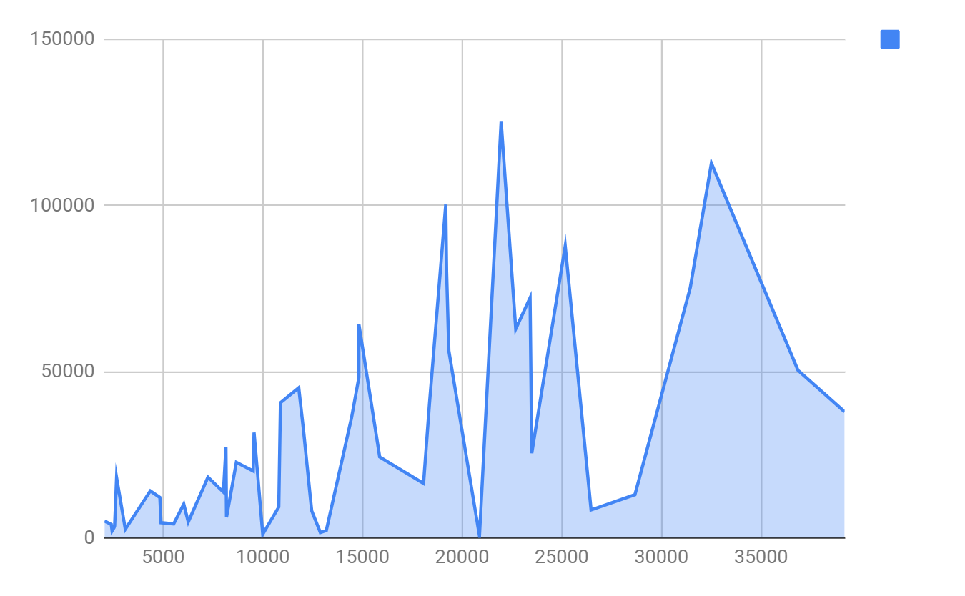
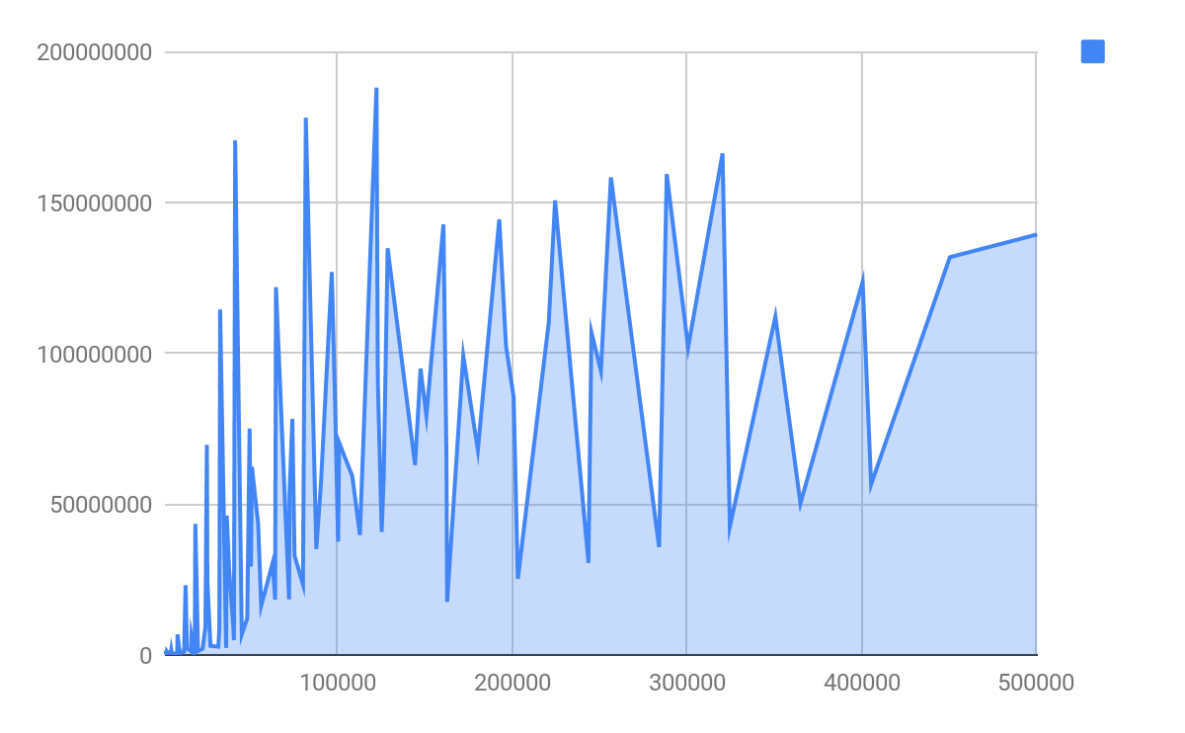
Breadth First Search vs Depth First Search
Search Time (ns)
Search Time (ns)
|V+E|
|V+E|
|V|: # of cities |E|: # of non-stop flights

Slide 9
Step 5 - Conclusion
Whether Depth-first search (DFS) algorithm can be used in place of BFS, why or why not.
Ans: DFS algorithm cannot be used in place of BFS in this case (where the shortest route has to be found), because DFS always search through the entire graph in order to compare all paths possible.
Once BFS finds the first path available, it is the shortest path (or one of the shortest). Worst case of BFS is no path, and it searches through the entire graph.

